Slide 1
MACHINE LEARNING TUTORIAL

Slide 2
CAMBRIDGE ANALYTICA FACEBOOK SCANDAL
https://www.youtube.com/watch?v=VDR8qGmyEQg

Slide 3
What is Machine Learning?
https://www.youtube.com/watch?v=ukzFI9rgwfU

Slide 4
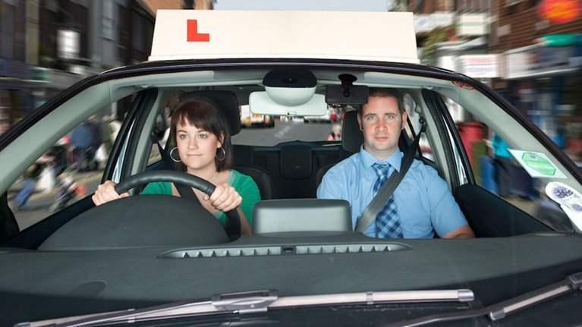
The Brain as a Neural Network ​
Our brain is basically a collection of neural networks. ​
​
Each neuron in our brain takes in many inputs and translates it to an output, just like a neural network. ​
​
Our brain is constantly calculating propensity scores, to make decisions. ​
Notes:
Take learning to drive, what are we trying to do when driving?​
​
Output variable: Crashing ​
Input variables: Weather, speed, road conditions, speed of other drivers, driving ability of other drivers ,traffic lights distance, car condition, cyclists, hazards, road signs etc. ​
​
When we initally learn to drive, our brain-model isn't very well trained. ​
Our brain trains itself through practice, to lower the error rate, and increase its accuracy with predicting the propensity of CRASHING. ​
The better we get at predicting a crash, the less likely we are to crash! ​
​
Our brain learns how different combination of factors effect the propensity to crash, and hence is always calculating propensities with different combinations. ​
​
Its sunny, there isn't much traffic, there isn't any traffic lights for at least two miles – my propensity to crash is low, hence my brain tells me I can speed up. ​
But if its snowing, and there isn't much traffic, and there wasn't any traffic miles for two miles – my propensity to crash is higher than when it was sunny, hence my brain tells me to stay the same speed. ​
​
This is the reason we are able to built self-driverless cars, because we are training a computer to act the same way as a brain when we learn to drive. ​
​

Slide 5
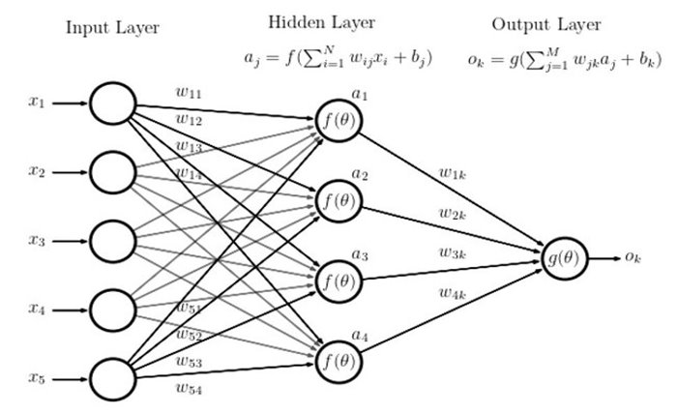
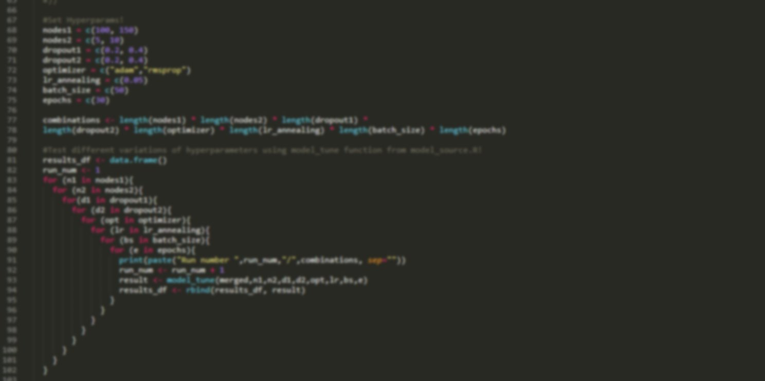
The Model
The model we use is a MLP neural network. ​
Our output variables are usually binary:​
Convert/do not convert​
Churn/do not churn​
Download brochure/do not download brochure​
Output is likelihood of the thing the we're trying to predict happening.​
Around 120 input features​
Backpropagation​
Hyperparameter tuning​
​
​
​
​

